Slide 1


Titolo presentazione sottotitolo
HW1 – Sound Classification
10574752 10751438 10612929 10486570
Milano, XX mese 20XX

Slide 2
Index
Audio effects classification – Introduction
Feature choice
First attempt
Final attempt
Dataset selection
Multi-class Weighted Support Vector Machine
Results

Slide 3
Audio effects classification - Introduction
ASSIGNMENT:
implement a classifier system able to predict the audio effect (between tremolo, distortion and noFX) used in recordings of electric guitar and bass.
IMPLEMENTATION:
Support Vector Machine with majority voting for multiclass classification.

Slide 4
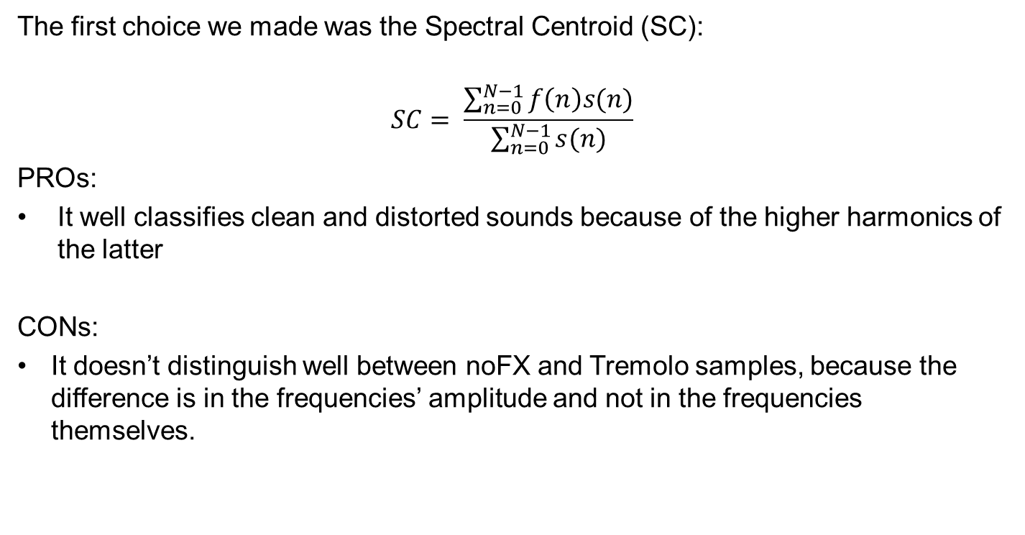
Feature choice – First attempt
The first choice we made was the Spectral Centroid (SC):
$$SC= \frac{\sum_{n=0}^{N−1}{f\left(n\right)s(n)}}{\sum_{n=0}^{N−1}{s(n)}}$$
PROs:
It well classifies clean and distorted sounds because of the higher harmonics of the latter
CONs:
It doesn’t distinguish well between noFX and Tremolo samples, because the difference is in the frequencies’ amplitude and not in the frequencies themselves.

Slide 5
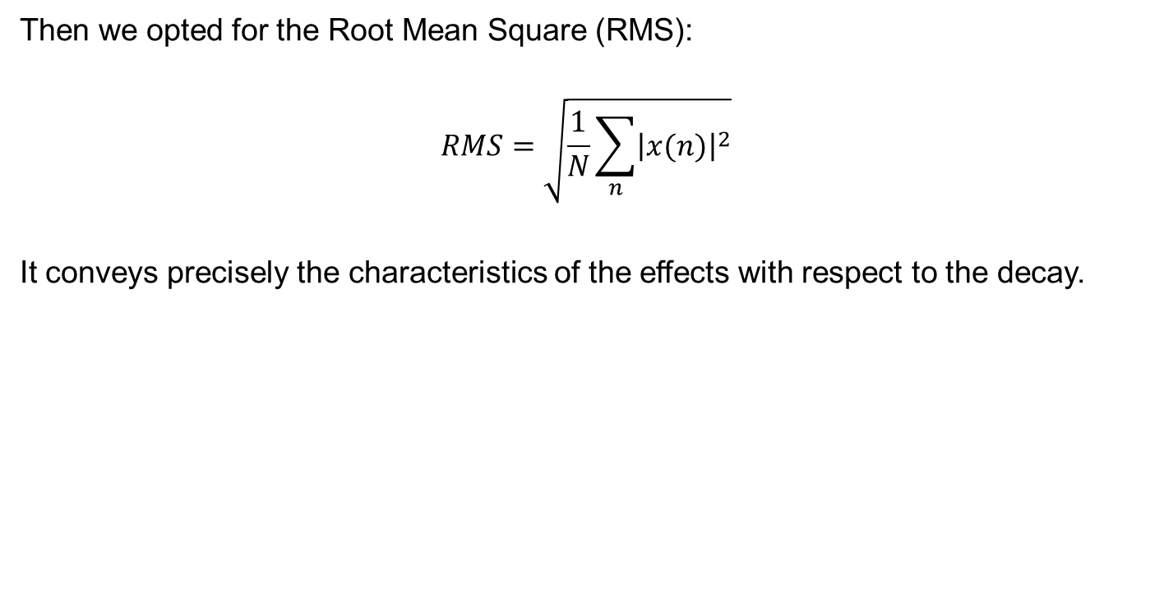
Feature choice – Final attempt
Then we opted for the Root Mean Square (RMS):
$$RMS=\sqrt{\frac{1}{N}\sum_{n}{{\left|x(n)\right|}^{2}}}$$
It conveys precisely the characteristics of the effects with respect to the decay.

Slide 6
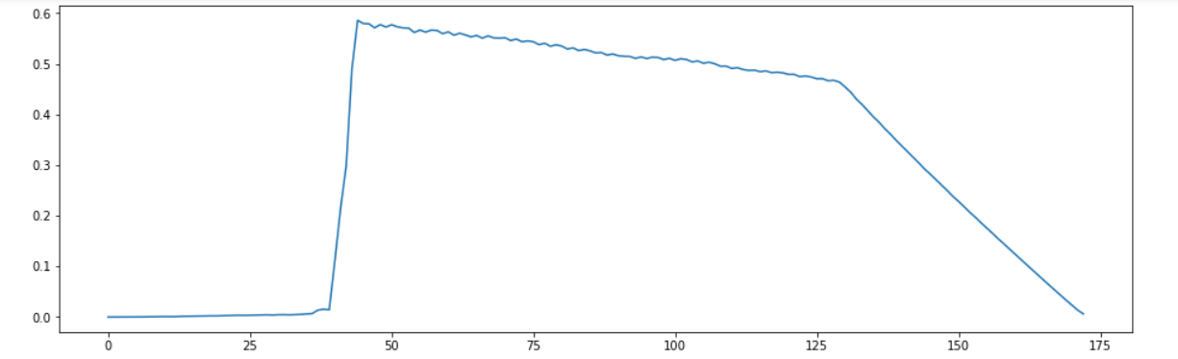
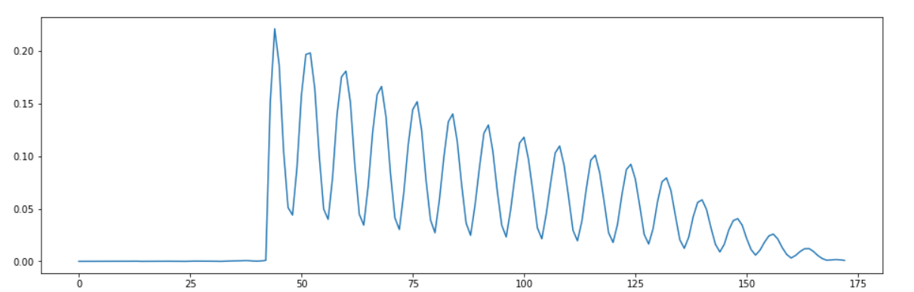
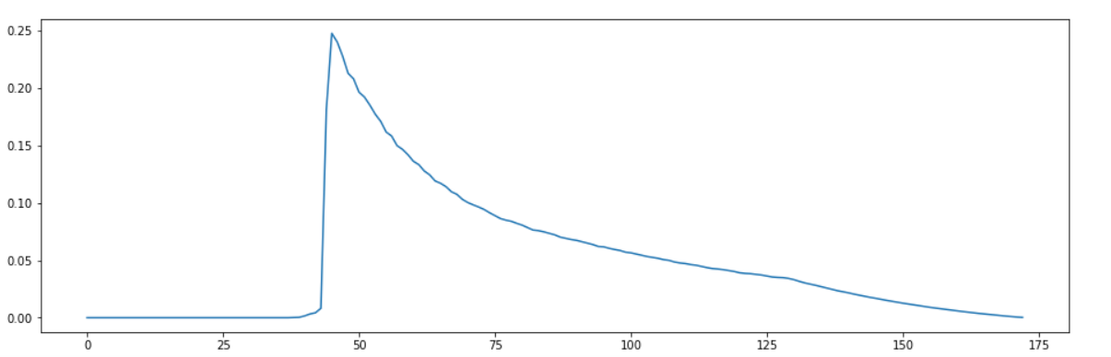
Feature choice – Final attempt
Distortion
Tremolo
noFX

Slide 7
Dataset selection
We decided to use only monophonic bass and monophonic guitar from IDMT-SMT-AUDIO-EFFECTS in order to have more homogeneous sample’s features.
 | Train (# elements) | Test (# elements)
Distortion | 1394 | 1238
Tremolo | 1194 | 1228
NoFX | 559 | 555
We divided the whole classes in about half for the train and the test sets, as shown in the table above.

Slide 8
Multi-class Weighted Support Vector Machine
SVMs are generally binary classifier, so, in order to manage 3 classes, we used one SVC for each couple of class: Distortion/Tremolo, Distortion/NoFX and Tremolo/NoFX. Each one misclassify the missing class, hence, applying majority voting, we are able to train and test the SVM with all the instances of the samples. Although we are working with an unbalanced training set (NoFX class is half of the others), the SVM model works well through the fine tuning of the C parameter, which is the number of tolerated severity applied to the margin violation.

Slide 9
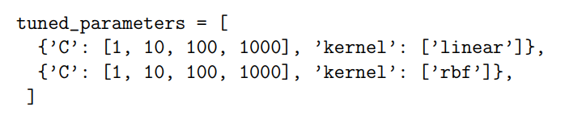
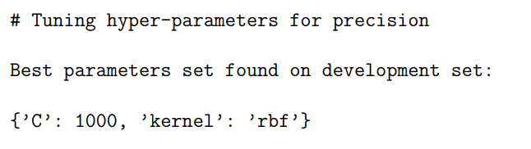
Multi-class Weighted Support Vector Machine
In order to select appropriate parameters for the SVM, we tested our classifier through Cross-validation using the function GridSearchCV from scikit-learns, in doing so we were able to
fine-tune the machine learning algorithm and to avoid overfitting the model.

Slide 10
Results
Confusion matrix of the RMS:
RMS | Distortion | Tremolo | NoFX
Distortion | 1219 | 19 | 0
Tremolo | 4 | 1224 | 0
NoFX | 7 | 1 | 547

